Slide 1


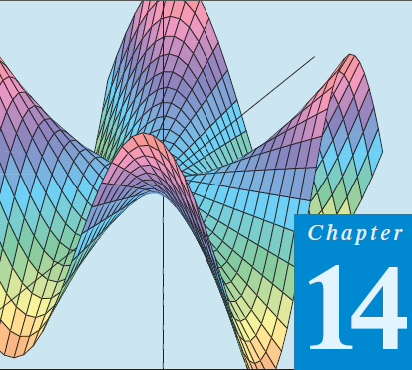
Thomas Calculus 11th
04
Partial Derivatives
Samuel Lukas

Slide 2

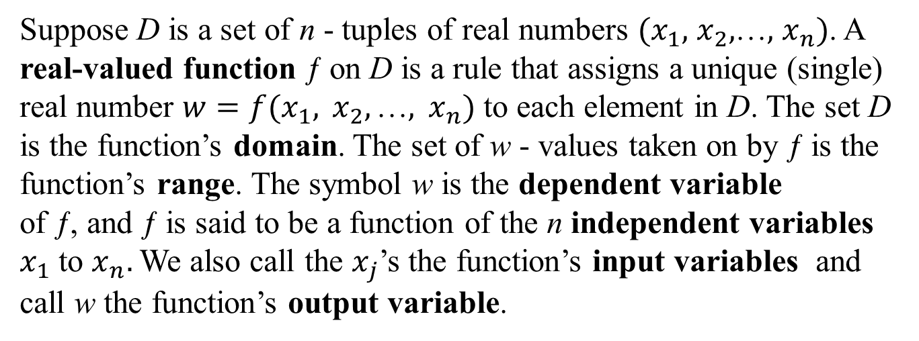
Function of Several Variables
Suppose D is a set of n - tuples of real numbers $(x_{1},$ $x_{2},$…$,$ $x_{n})$. A real-valued function ƒ on D is a rule that assigns a unique (single) real number $w=f(x_{1}, x_{2},\text{…}, x_{n})$ to each element in D. The set D is the function’s domain. The set of w - values taken on by ƒ is the function’s range. The symbol w is the dependent variable
of ƒ, and ƒ is said to be a function of the n independent variables $x_{1}$ to $x_{n}.$We also call the $x_{j}$’s the function’s input variables and call w the function’s output variable.

Slide 3
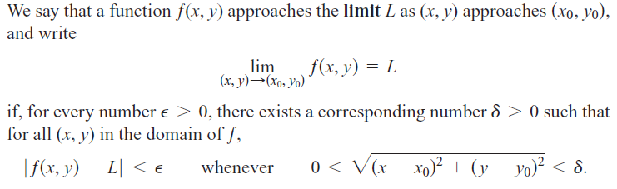


Limit of a function of two variables
a)
b)
c)

Slide 4
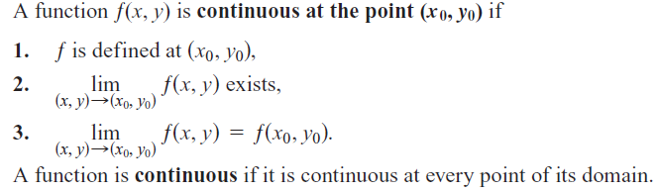
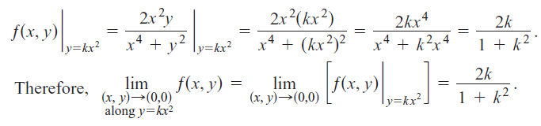
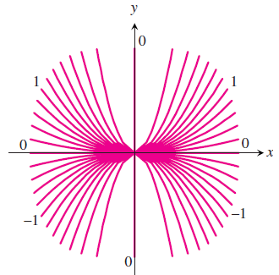
Continuous function of two variables

Slide 5



Exercises 1
Find the limits by rewriting the fractions first.
At what points (x, y) in the plane are the functions continuous?

Slide 6
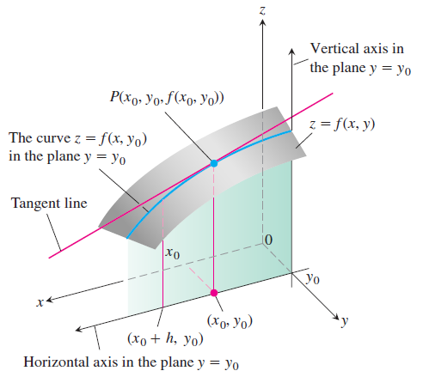
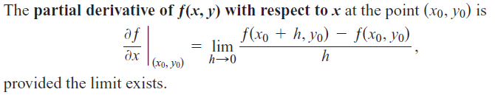
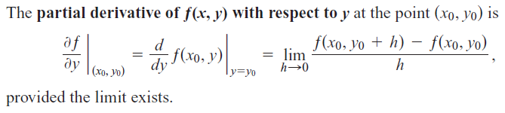
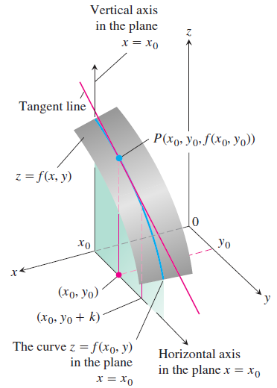
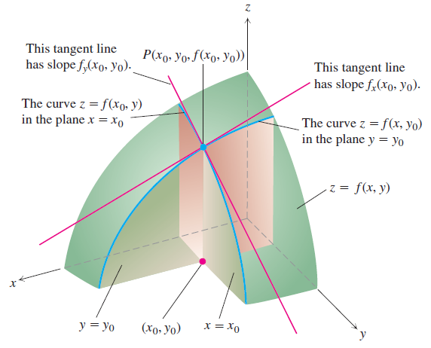
Partial Derivatives

Slide 7




Examples : 1

Slide 8











Slide 9
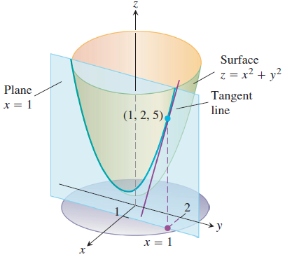
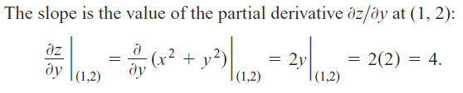


Slide 10


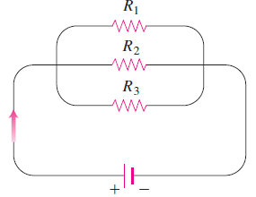




More than two variables

Slide 11






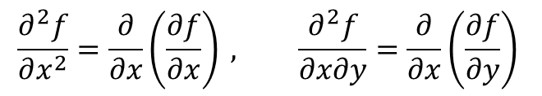
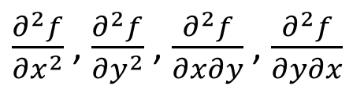
Second Order Derivatives
When we differentiate a function ƒ(x, y) twice, we produce its second-order derivatives. These derivatives are usually denoted by
$\frac{∂^{2}f}{{∂x}^{2}}$ , $\frac{∂^{2}f}{{∂y}^{2}}$ , $\frac{∂^{2}f}{∂x∂y}$ , $\frac{∂^{2}f}{∂y∂x}$
$$\frac{∂^{2}f}{∂x^{2}}=\frac{∂}{∂x}\left(\frac{∂f}{∂x}\right) , \frac{∂^{2}f}{∂x∂y}=\frac{∂}{∂x}\left(\frac{∂f}{∂y}\right)$$

Slide 12




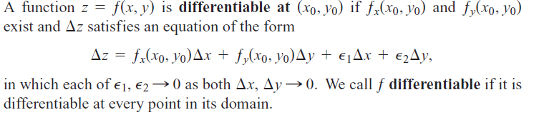
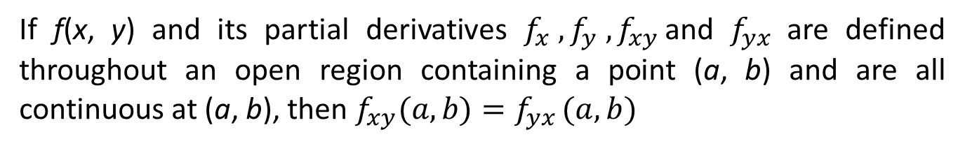
The Mixed Derivative Theorem
If ƒ(x, y) and its partial derivatives $f_{x} ,f_{y} ,f_{xy }$and $f_{yx}$are defined throughout an open region containing a point (a, b) and are all continuous at (a, b), then $f_{xy}(a,b)=f_{yx }(a,b)$

Slide 13
Some Definitions
If the partial derivatives f_{x} and f_{y} of a function ƒ(x, y) are continuous throughout an open region R, then ƒ is differentiable at every point of R.
If a function ƒ(x, y) is differentiable at (x₀ ,y₀), then ƒ is continuous at (x₀ ,y₀).

Slide 14





Exercises 2
In Exercises, find f_{x},f_{y}
In Exercises, find f_{x},f_{y}, f_{z}

